Slide 1







CONNECT
Software architecture

Slide 2



Concepts
The application renews the old-fashioned event manager systems, and extends them with a wide variety of features.

Slide 3

Processing units
Live feed service
Ticketing service
User service
Event service
Recommending service
Notification service

Slide 4
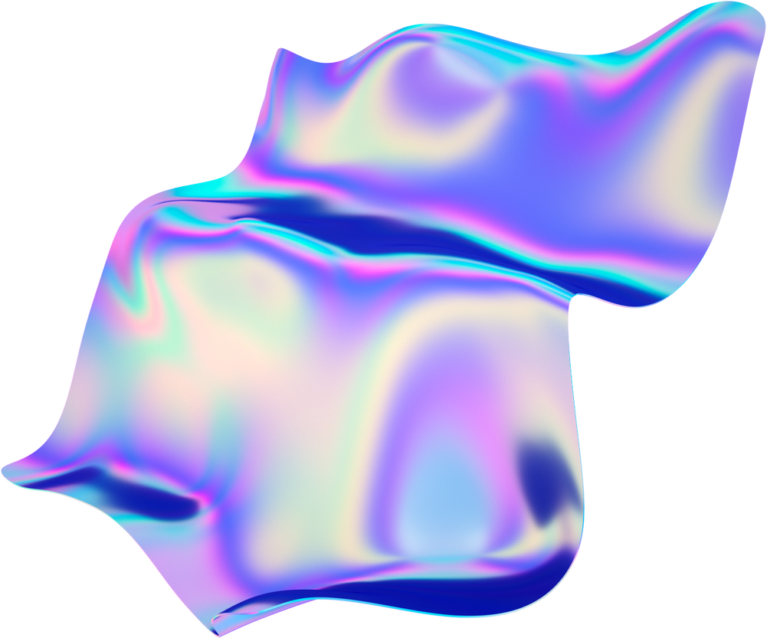
Bottlenecks
Up to date content all the time on the feed
Handling huge data operations
Handling large user base
Purchasing tickets simultaneously
Scalability
Data loss

Slide 5

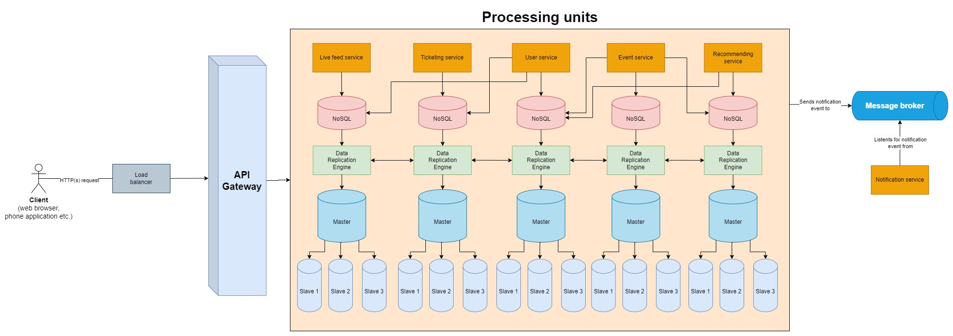

Solution

Slide 6
Thank You
Csirák Dávid
Tóth Péter Balázs
Varga József Márk

